Slide 1
Laptop Price Analysis
By: Vishweshwar Satpute
satputevishweshwar@gmail.com
Nov 19 Cohort

Slide 2
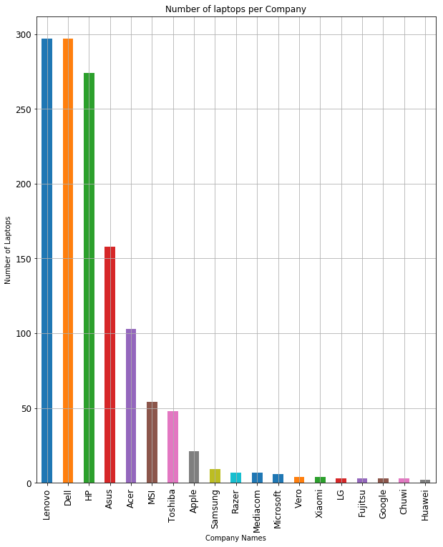
Laptops Counts
The bar graph illustrates, different brands of laptop and their respective counts.

Slide 3
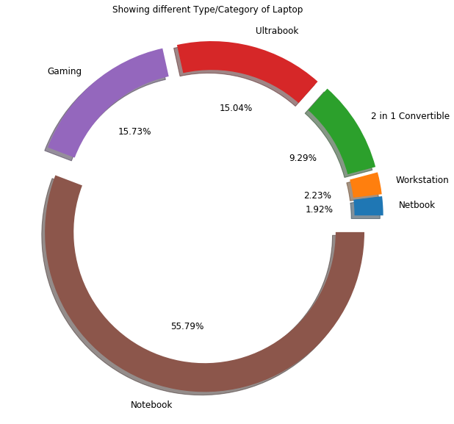
Showing different Type/Category of Laptop
The Pie chart represents, the types of laptop Such as: Gaming, Ultrabook, Workstation and so forth, with their total shares in percentage.

Slide 4
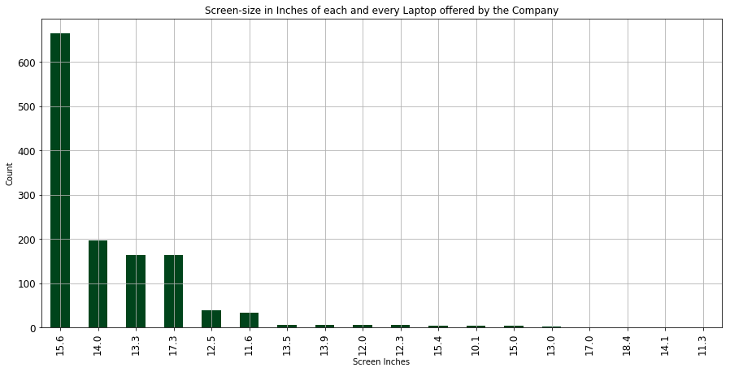
Screen-size in Inches of each and every Laptop offered by the different Company's

Slide 5
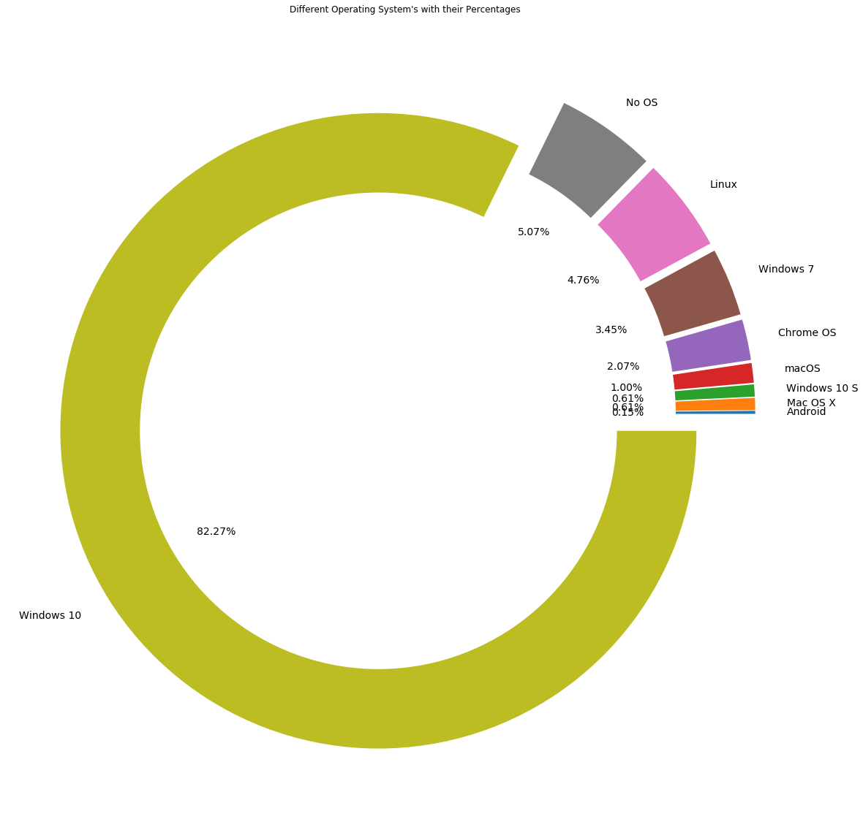
Different OS with their Percentages

Slide 6
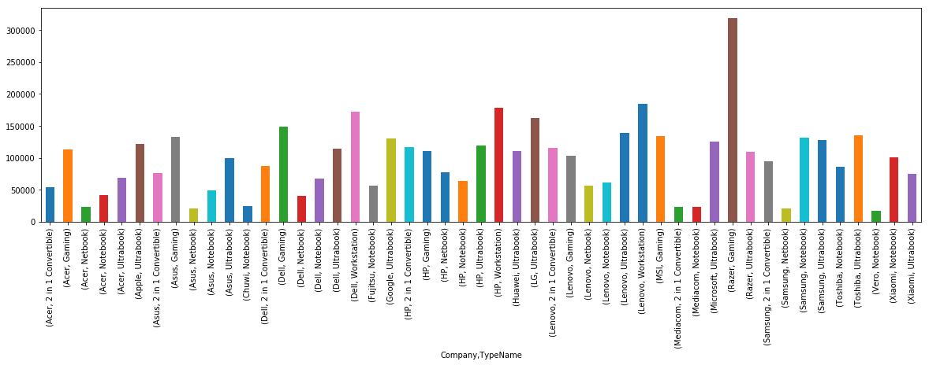
Pricing Distribution bases Company & Types
Bar graph shows, all type of laptop with their pricing

Slide 7
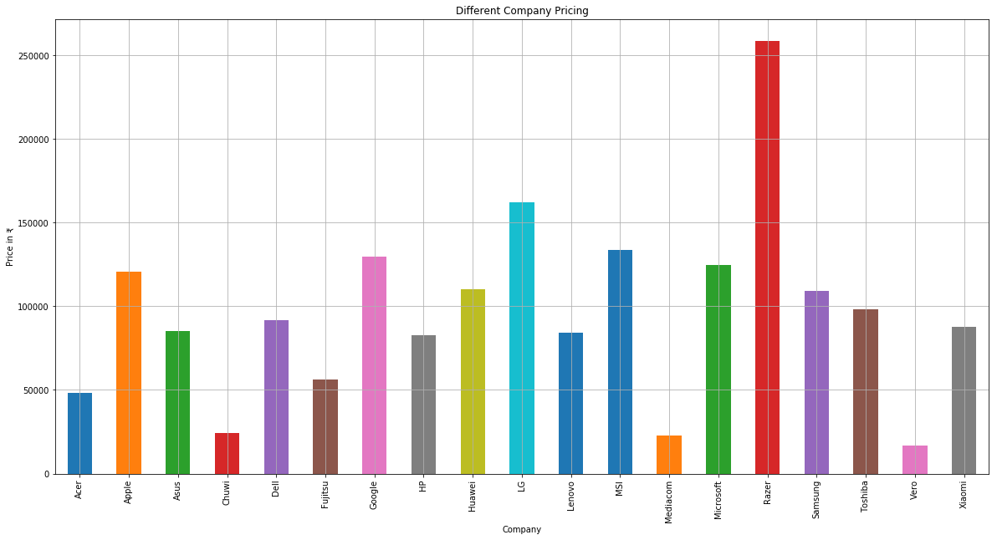
Different Company Pricing
The graph provides information about Pricing for different companies.
Observation: Razer has the most expensive laptop and the least pricing is for Vero.

Slide 8
Comparison Overview
Let us now compare all the specifications difference, of the most expensive laptop to that off the least.
Specification comparison in terms of Ram, Memory, CPU – Processor, Screen Resolution, Type, GPU.
Agree, there are many factors which affect the pricing of the laptop, however considering the available options, the key Components which has a significant impact on the Price of a Laptop.
Considering the above parameters, Comparing Highest vs Lowest Priced Laptops.
Also comparing Inch | RAM | Weight of both
Highest Price Laptop (Razer)
Lowest Price Laptop (Vero)
Processor
RAM
Memory

Slide 9
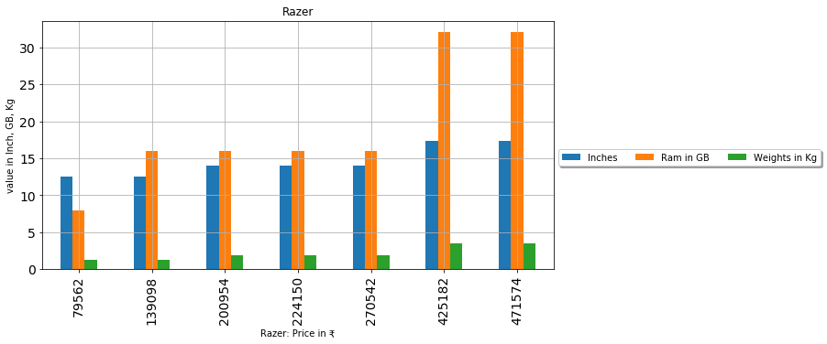
Highest Price Laptop Razer

Slide 10
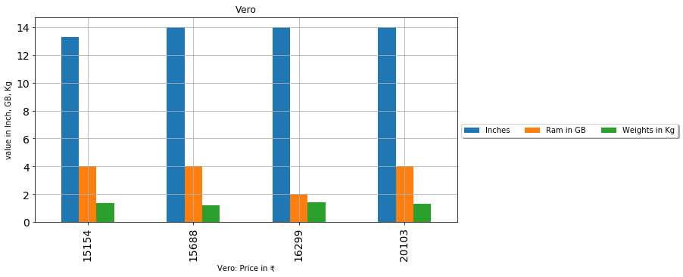
Lowest Price Laptop Vero

Slide 11
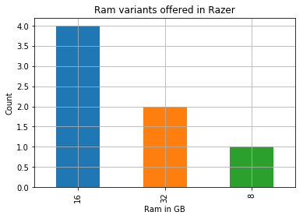
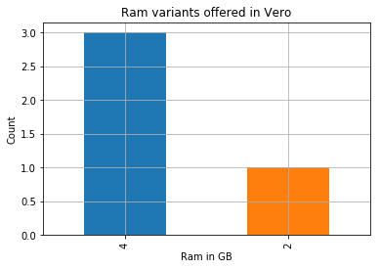
Razer VS Vero
Specification comparison between Highest and lowest pricing laptops.
RAM: Comparison between Razer vs Vero

Slide 12
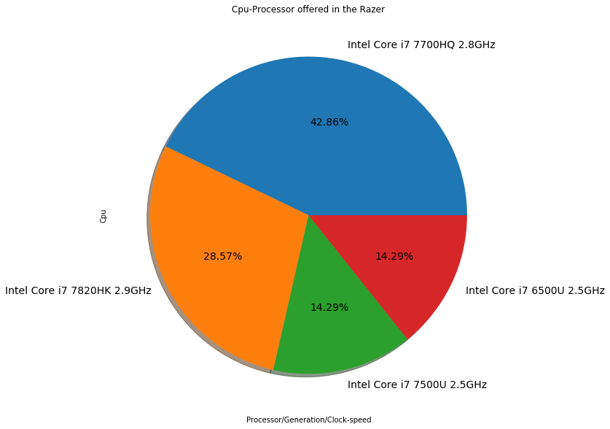
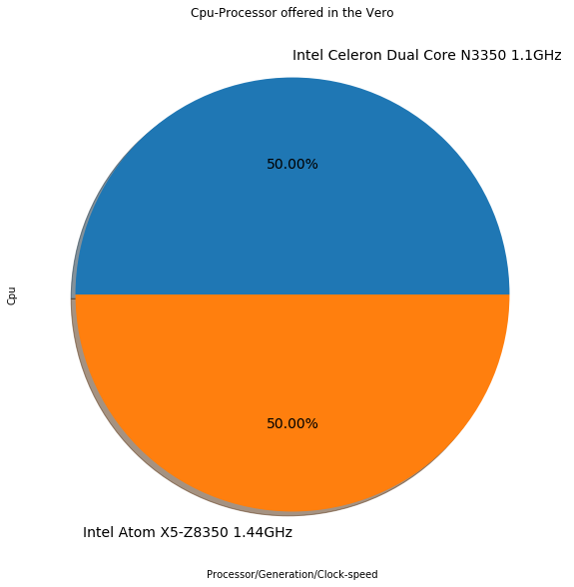
CPU: Comparison between Razer vs Vero

Slide 13
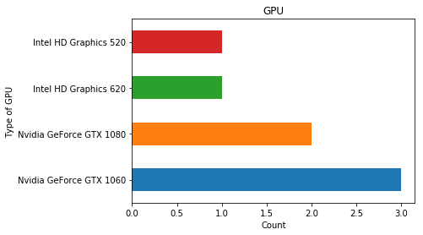
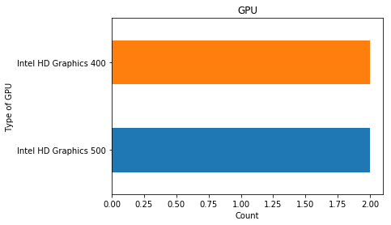
GPU: Comparison between Razer vs Vero

Slide 14
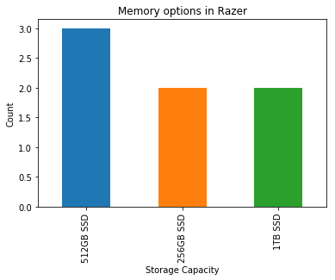
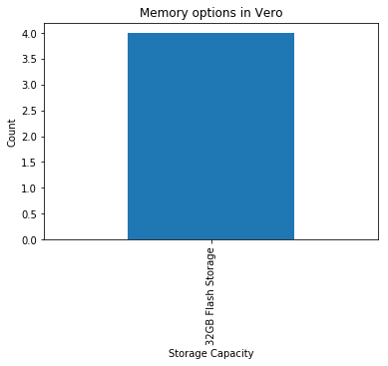
Memory: Comparison between Razer vs Vero

Slide 15
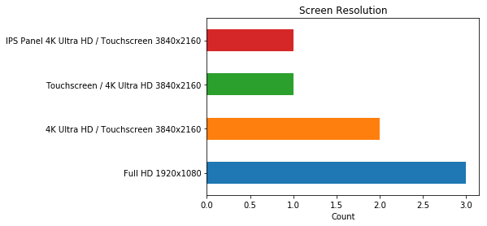
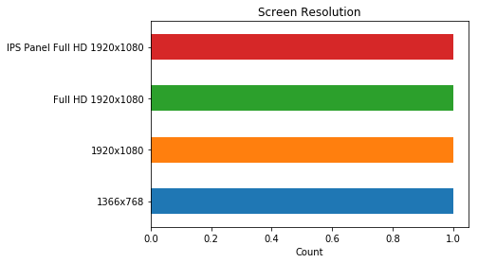
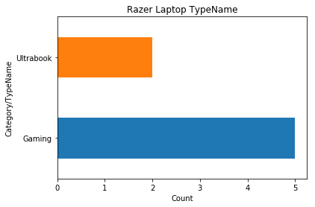
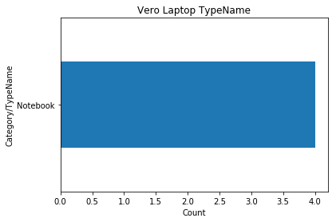
Screen Resolution & TypeName : Comparison between Razer vs Vero

Slide 16
Thank You

